Slide 1
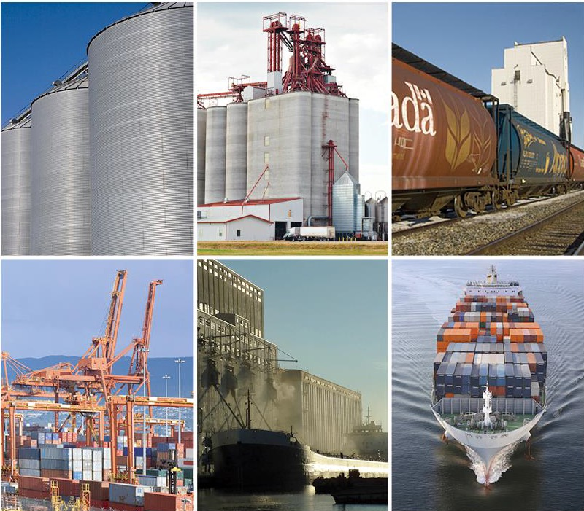
Industry approaches to proactively mitigate missing MRLs
Gordon Bacon
Pulse Canada
GOVERNMENT-INDUSTRY WORKSHOP ON MISSING MRLS
Notes:
Intro, salutations

Slide 2
Structural shift in in trading environment
  More missing MRLs and potential application of defaults
    (greater number of missing MRLs as more countries move away from the global standard (Codex) and adopt country-specific MRL lists)
  Residue testing more sensitive
  Heightened monitoring/testing
  Hazard-based MRLs?
Notes:
I’m going to spend the remainder of my brief time with you this afternoon to share with you the quantitative results from our initial analysis of publicly reported global MRL noncompliances, and I’d also like to touch on IAFN coalition efforts. First, I’d like to share with you the Canadian pulse industry perspective on why we’re worried that this problem will get worse before it gets better.
As you know, there are more countries moving away from Codex deferral toward national MRL lists.
Also, advances in analytical chemistry have made it possible to detect extremely minute levels of pesticide residue, in many cases well past levels of biological significance.
In terms of heightened monitoring/testing, unfortunately we are still too reliant on anecdotes rather than hard data, but it takes a special kind of optimist to think that this isn’t on the rise.

Slide 3
More missing MRLs – prevalence of national MRL lists
Number of countries – no weighting
Complex mix of systems in use globally
Codex is global standard, but fewer countries utilizing
Several key trading partners have national lists, but also defer to Codex if an MRL is missing
2015 Canadian Export Destinations – 91 Countries
Notes:
So now I’d like to walk you through the numbers. This pie chart shows the MRL sources or deferral paths of 91 countries that import Canadian grains, oilseeds or pulses. Since the yellow and green pies represent the countries that use or will defer to Codex MRLs, only one-third (approximately) of the 91 are using Codex, the global MRL reference.

Slide 4
Publicly reported global MRL noncompliances
Total number of noncompliances reported during the most recent year of publicly available data:
2,907
MRL violations for most recent one-year period with available data. US: October 1, 2013 – September 30, 2014; Canada: April 1 2013 – March 31, 2014; Australia, EU, Hong Kong, Japan, & Taiwan: July 1, 2016 until June 30, 2017.
Notes:
Currently, there are 7 jurisdictions only that publicly report MRL noncompliances– US, Taiwan, EU, Canada, Japan, Australia, Hong Kong. These are public figures, and the contribution we have made in this case is simply to have compiled that information with the intent of creating a time series to enable meaningful evaluation of how noncompliances change over time. We are still working out a few bugs in the data, and I will note two cases in the next slides where our numbers must be considered provisional as a result.
Gordon, for your information in case you are asked:
Most of these are horticulture, not grain, examples. (I refer to grain here as cereals, oilseeds and pulses). One exception would be oat/glyphosate noncompliances recently going into Taiwan, but in my opinion it’s poor etiquette to point out others’ MRL noncompliances.
Some examples if you’re asked:
EU rejected malathion (0.071 mg/kg - ppm) in dried mung beans (Vigna radiata) from Ethiopia
Taiwan rejected Whole Oat Groats due to Glyphosate

Slide 5
Proportion of MRL noncompliances due to no MRL or default – provisional data
MRL violations for most recent one-year period with available data. US: October 1, 2013 – September 30, 2014; Australia, EU, Japan, & Taiwan: July 1, 2016 until June 30, 2017. Taiwan and Japan violations of 0.01 ppm or less marked as “No MRL or default”
Notes:
This slide is particularly germane to the topic of missing MRLs. It shows the proportion of MRL noncompliances by jurisdiction that resulted from missing MRLs versus misaligned MRLs.
As you can see, a large majority is due to missing MRLs, 87%. However, it is likely higher because of the problems distinguishing between scientifically-derived 0.01 ppm EU MRLs vs. EU default MRLs set at the same level. This chart is currently based on the assumption that many 0.01 EU MRLs are set at that level after review of the data.

Slide 6
MRL noncompliances by continent of origin
MRL violations for most recent one-year period with available data. US: October 1, 2013 – September 30, 2014; Australia, EU, Japan, & Taiwan: July 1, 2016 until June 30, 2017. Taiwan and Japan violations of 0.01 ppm or less marked as “No MRL or default”
Notes:
So now we know something about the MRL noncompliances in each of the 7 jurisdictions that were testing products destined for their own grocery store shelves. What does the data tell us about *where* those shipments originated? This chart shows the continents of origin, including a breakdown of noncompliances resulting from missing versus misaligned MRLs. Obviously Asia and Latin America are in the lead when it comes to encountering noncompliances in the importing country due to missing MRLs. But which country specifically? (switch to next slide)

Slide 7
MRL Noncompliances by Country of Origin
 | Country | Violations
1. | China | 380
2. | Mexico | 355
3. | United States | 292
4. | India | 250
5. | Turkey | 136
6. | Japan | 130
7. | Vietnam | 128
MRL violations for most recent one-year period with available data. US: October 1, 2013 – September 30, 2014; Canada: April 1 2013 – March 31, 2014; Australia, EU, Hong Kong, Japan, & Taiwan: July 1, 2016 until June 30, 2017.
Notes:
This is the same data, but broken down by country of origin, rather than continent of origin. It is interesting to note how many noncompliances are experienced by countries that we would otherwise not consider to be large agri-food exporters. And we know anecdotally that African countries have faced a significant number of missing MRLs in the EU, which likely explains why the “other” category contains 480 or about 1/6th of the total noncompliances.
So what’s the takeaway from this slide? We suspect there are many depending on who’s interested in what part of the problem and the solution areas, but certainly we can conclude that this is having significant effects, and it’s having significant effects in the parts of the world whose economies could benefit from trade-enabling solutions. Yet another potential take away is that while this is primarily a horticulture story at this time, it’s a growing concern for the grain industry – which is responsible for transboundary movement of large volumes of staple crops for basic nutrition and food security, rather than more specialized products – and there’s an opportunity to develop trade enabling solutions before the global grain trade begins to experience the same adverse effects.
Gordon, some individual observations on noncompliances involving NAFTA countries:
In the past three years, there have only been a handful of non-compliances for NAFTA-origin products sent to non-NAFTA countries. These include U.S. fresh onions, raw corn, and tea going to Taiwan, and Mexican green beans and avocados to Japan and chili powder to Taiwan.

Slide 8




MRL case studies underway by IAFN coalition
Quinoa, Peru;
Peas and Beans, Kenya;
Cranberries, US
Others TBC

Slide 9
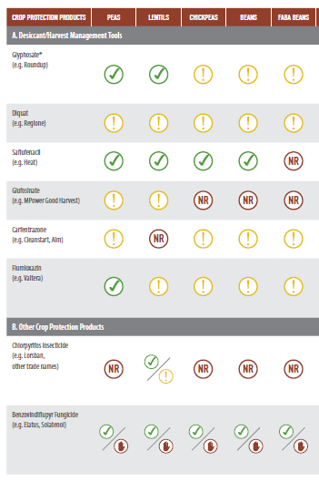
Managing Risk of Noncompliance
Short term: ensure use of active ingredient will not create unacceptable level of trade risk:
  Balance, not eliminate, trade risk
  Canadian example: multi-commodity grower advisory www.keepingitclean.ca
Medium term: work to attain the required MRL (if possible)
Medium/Longer term: broader, multi-commodity, multi-country efforts to advocate for trade enabling solutions for MRL trade risk through improved institutions (Codex), regulatory cooperation, trade agreements, etc.
Notes:
Our grower and trade people made it very clear to us that we needed to go out and address this problem. The short term solution is to – unfortunately – take steps to limit uses of the product that results in an unacceptable level of trade risk (I want to emphasize “unacceptable”, because under current circumstances zero trade risk can never be achieved – more on this in a minute). The medium-term solution is to take steps to attain the required MRL. The longer term solution is to identify areas of opportunity around regulatory cooperation.

Slide 10
National list, defer to Codex – a solution?
Country | MRL Scheme
United States | National only, zero default (any detectable residue is a violation)
Canada | National only, 0.1 ppm default
Japan | National only, 0.01 ppm default
Australia | National only, zero default (any detectable residue is a violation)
Mexico | National , defers to US MRLs if missing national MRL, undefined default
Peru | National, defers to Codex if missing national MRL, then U.S., then EU; undefined default
Singapore | National, defers to Codex if missing national MRL, undefined default
Brunei | National, defers to Codex if missing national MRL, undefined default
Malaysia | National, defers to Codex if missing national MRL, 0.01 ppm default
New Zealand | Applies least restrictive of New Zealand national MRL or Codex, 0.1 ppm default
Chile | National, defers to Codex if missing national MRL, undefined default
Vietnam | National, presumed to defer to Codex if missing national MRL, undefined default
Notes:
Here is a set of examples showing 7 countries that utilize Codex MRLs – so fall into the green or yellow categories on the previous slide – and 5 others that fall into the national only category. It also shows whether the country has a defined default.
These happen to be the countries in the original transpacific partnership negotiations, and we’ve included these 12 countries as examples because they nicely show a symmetry that close to half utilize national lists only*, while the remainder uses national lists BUT will utilize the Codex MRL if the national MRL is missing. The latter category is vastly more trade-enabling than the former.

Slide 11
And now on to the panel!

